Slide 1
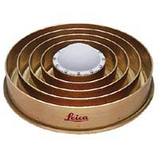
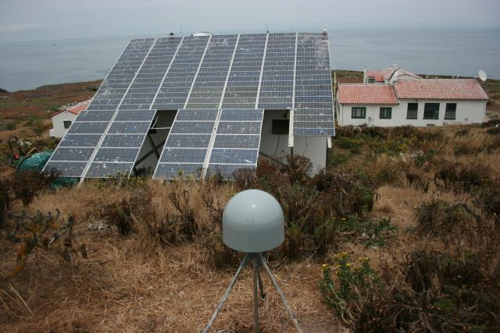
MULTIPATH
ASEN 5090 Lecture 15
ASEN 5090 LECTURE NOTES – LARSON, AXELRAD

Slide 2
Homework 6
Read the header (like you did for homework 5)
[fid, rec_pos, ObsTypes] = read_rinex_header(obs_file);
datas = read_rinex_obs3(obs_file);
You can restore this information dcol = datas.col; obs = datas.data;
dcol =
WEEK: 1
TOW: 2 (time of week)
PRN: 3
L1: 4
L2: 5
C1: 6
P2: 7
S1: 8
S2: 9
So if you want TOW for the first measurement in the file, that would be obs(1,dcol.TOW);
If you want S1 for the first epoch, that would be obs(1, dcol.S1)

Slide 3
Homework 6
I don’t like that Ben’s code reads the entire file. It would be better (IMHO) if it read only the number of epochs you requested. I have code that does that – but there is no perfect code (mine likely has other problems).
If you want to know the names of the specific epochs in the file, you can use the matlab function unique.
For homework 6, I only want you to use the first time epoch in the file.

Slide 4
the simplified GPS pseudorange observable equation
ionosphere
relativity
Observable P1 or C1
geo range
sat clk
noise
rec. clk
troposphere
multipath
4

Slide 5
Outline for Multipath
What causes multipath?
How can you avoid it?
How does multipath affect GPS pseudorange measurements?
SNR data?
Can multipath be useful?

Slide 6
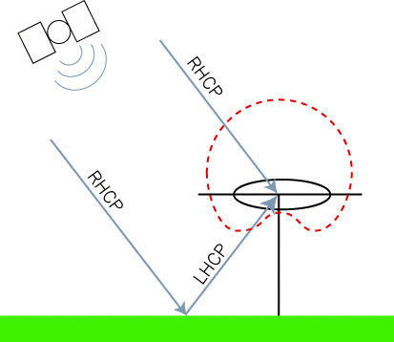
Multipath
Definition: A signal that arrives at the antenna by an indirect path.
Multipath is always delayed relative to the direct signal.
Diffuse multipath results from rough surface reflections – causes noise
Specular multipath results from smooth surfaces – causes oscillations in pseudorange, phase, SNR data
We will focus entirely on specular multipath here.
Specular reflection is the mirror-like reflection of light (or other waves) from a surface, in which light from a incoming direction (a ray) is reflected into a single outgoing direction Discovered in first century AD!
6
K. Larson and P. Axelrad, University of Colorado

Slide 7
Let’s talk a little more about this picture
7
K. Larson and P. Axelrad, University of Colorado

Slide 8
8
K. Larson and P. Axelrad, University of Colorado

Slide 9
9
K. Larson and P. Axelrad, University of Colorado

Slide 10
So if you want to get rid of multipath – what do you do?
10
K. Larson and P. Axelrad, University of Colorado

Slide 11
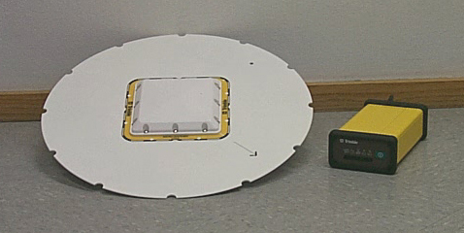
Avoiding and reducing multipath
Antenna based mitigation
RHCP vs LHCP
Ground planes and choke rings
Siting - install GPS sites away from reflecting materials
Improved receiver technology
Narrow correlator spacing (will defer discussion until receiver section)
Signal and data processing
Smoothing
Correlation in time
Antenna with ground plane
Choke ring antenna
K. Larson and P. Axelrad, University of Colorado

Slide 12
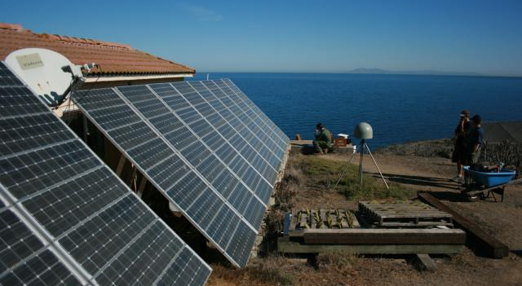
Silly place to put a GPS receiver

Slide 13
Data Processing Methods
K. Larson and P. Axelrad, University of Colorado

Slide 14
K. Larson and P. Axelrad, University of Colorado

Slide 15
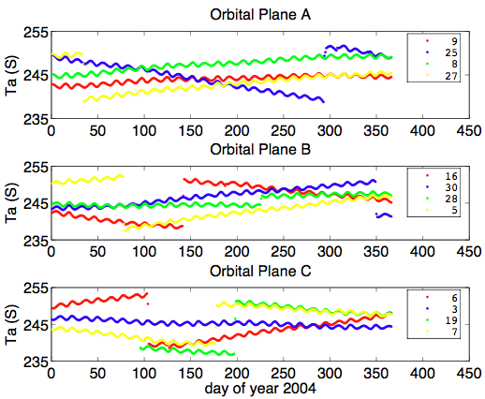
Complications – But Interesting for Aero Folks
K. Larson and P. Axelrad, University of Colorado

Slide 16
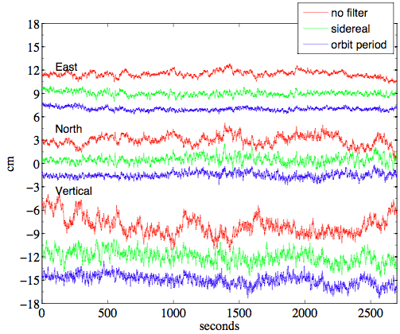

Slide 17
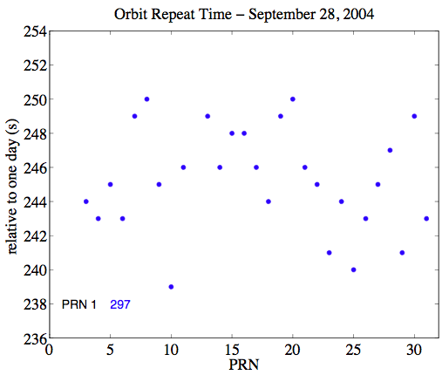
17
K. Larson and P. Axelrad, University of Colorado

Slide 18
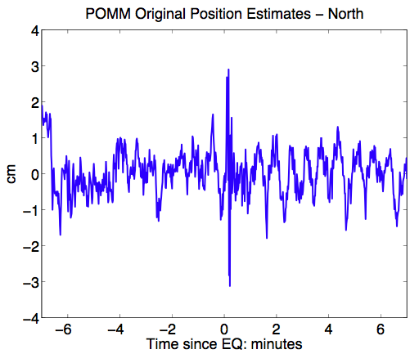
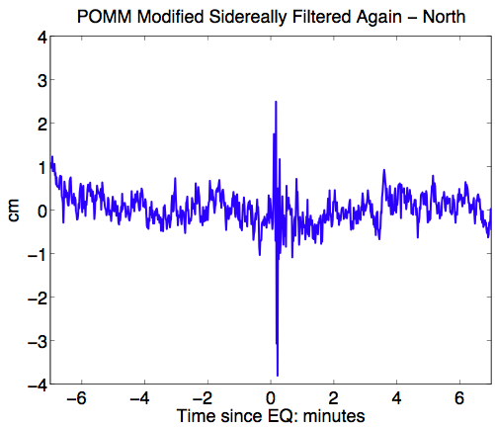
18
K. Larson and P. Axelrad, University of Colorado

Slide 19
Back to Kepler’s Laws
Orbit repeat periods tell you how long a satellite takes to circle the Earth.
What we really want to know is how the ground track (or aspect) repeats. Ground tracks are what correspond with the GPS observables.
Do aspect repeat periods give you the same answer as orbit repeat periods?
No

Slide 20
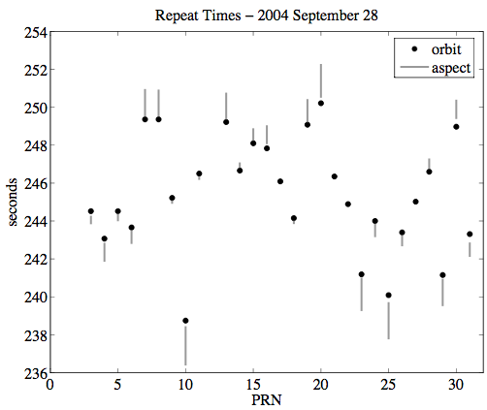
20
K. Larson and P. Axelrad, University of Colorado

Slide 21
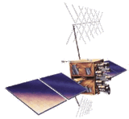
General Problem
GPS
transmitter
Reflector geometry (elevation angle and antenna height) and GPS transmit frequency
The reflector characteristics (dielectric constant, smoothness of the surface)
The gain pattern of the receiving antenna (s).
Number of receivers.
GPS
instrument
Reflection Surface

Slide 22
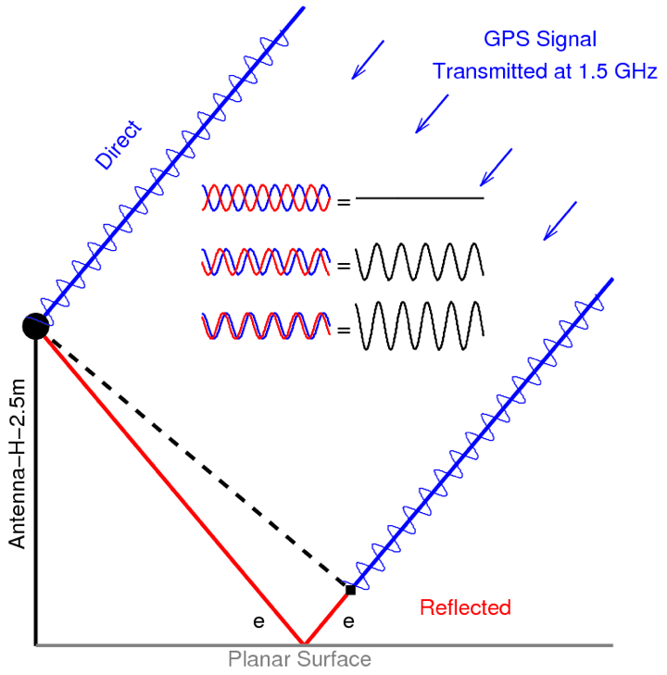

Slide 23
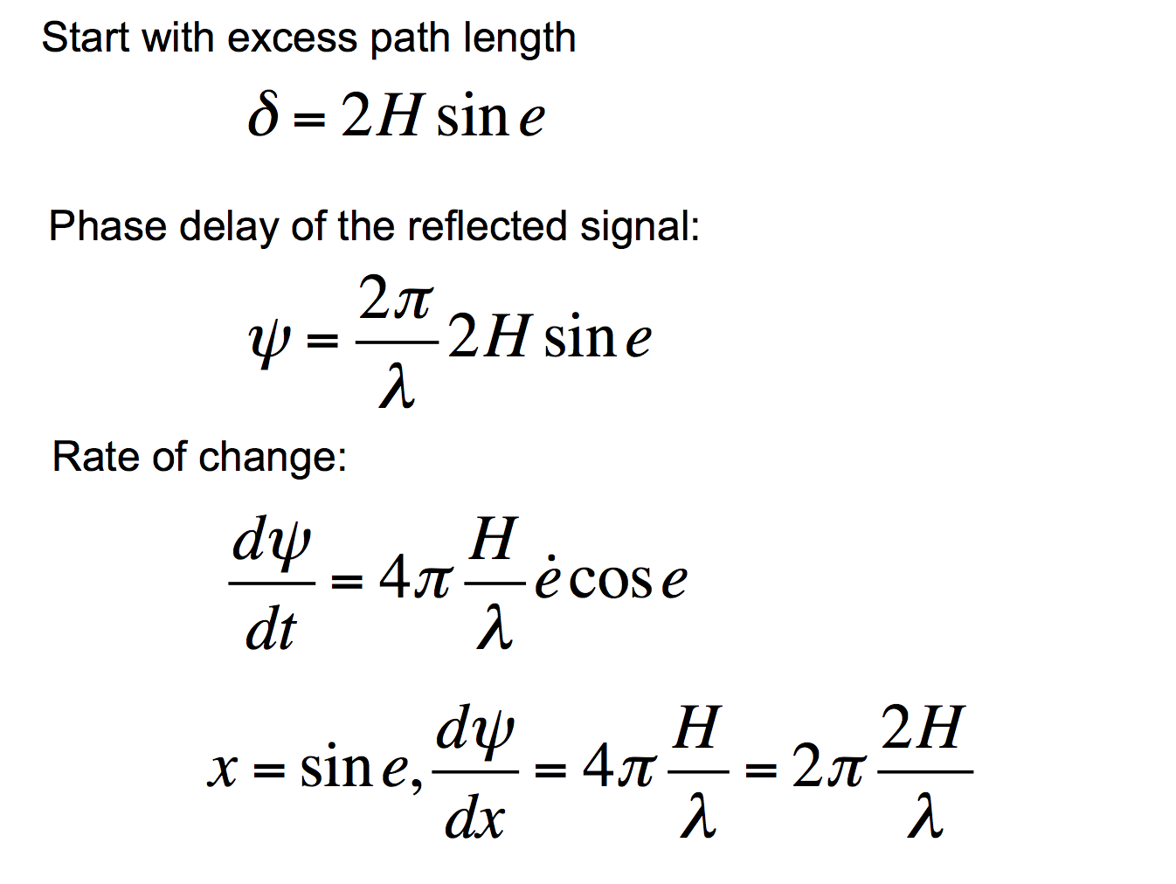
Change of variable

Slide 24
How does that extra path length influence the GPS observables? 1. Pseudorange 2. Signal to Noise Ratio data

Slide 25
How does multipath affect pseudorange measurements?
M

Slide 26
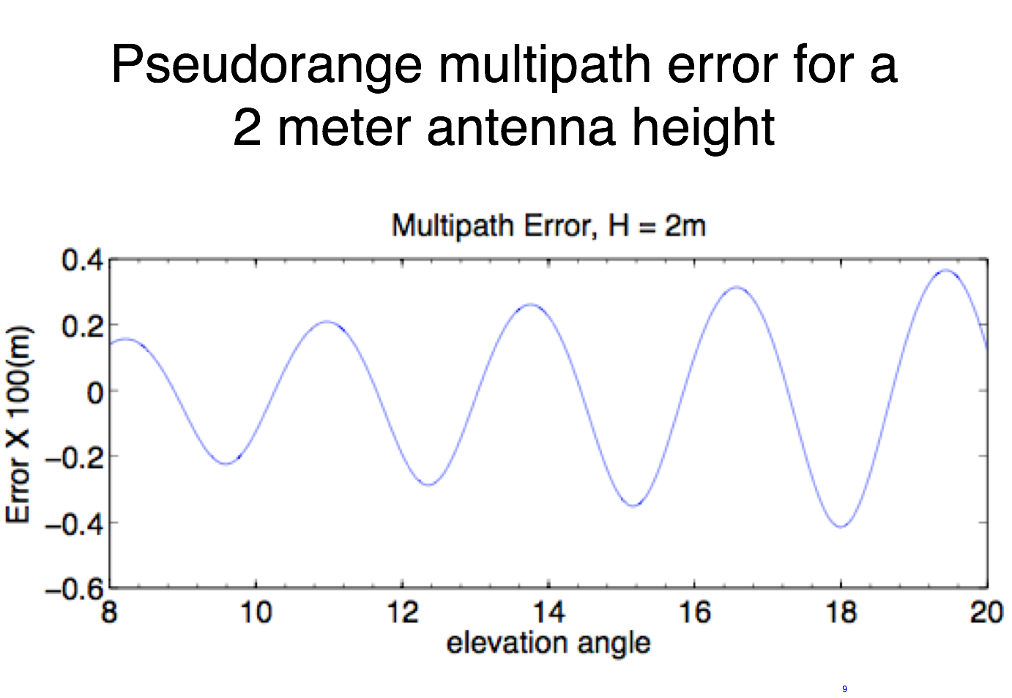

Slide 27
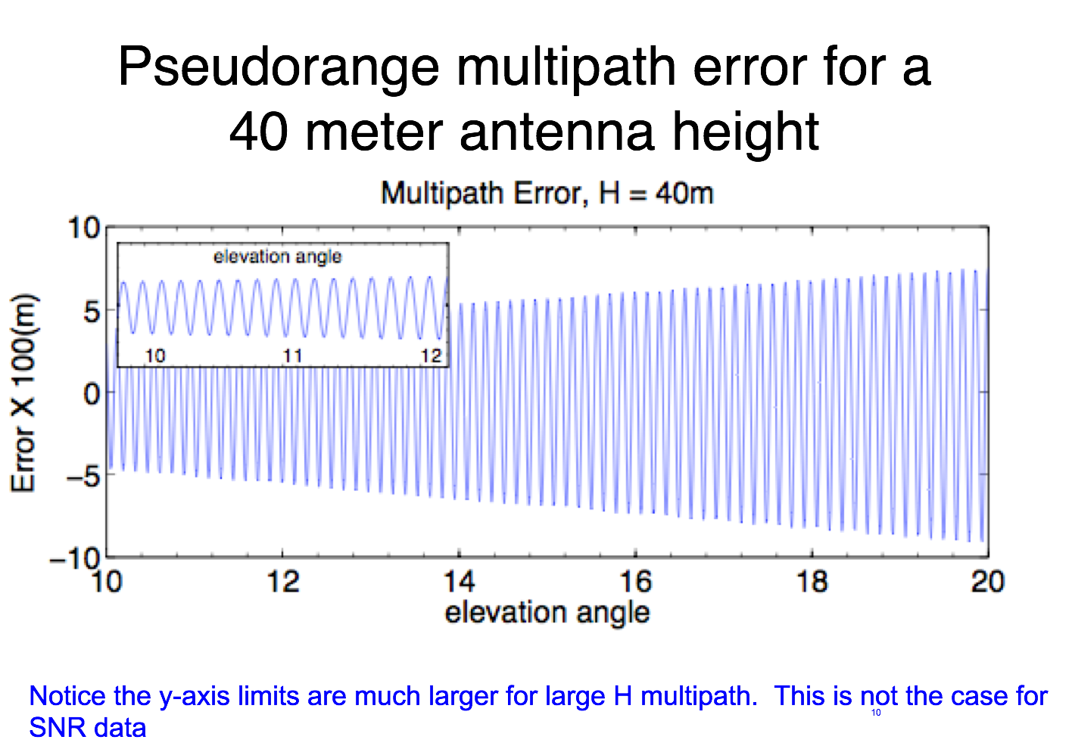

Slide 28
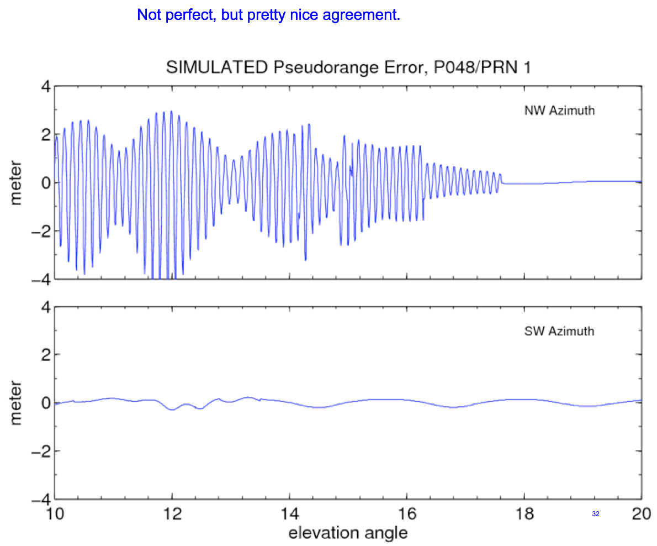
Simulation – taking into account the gain pattern

Slide 29
GPS
transmitter
Simple case
GPS
instrument
Reflection Surface

Slide 30
Real life
close reflector multipath
reflecting surface
30

Slide 31
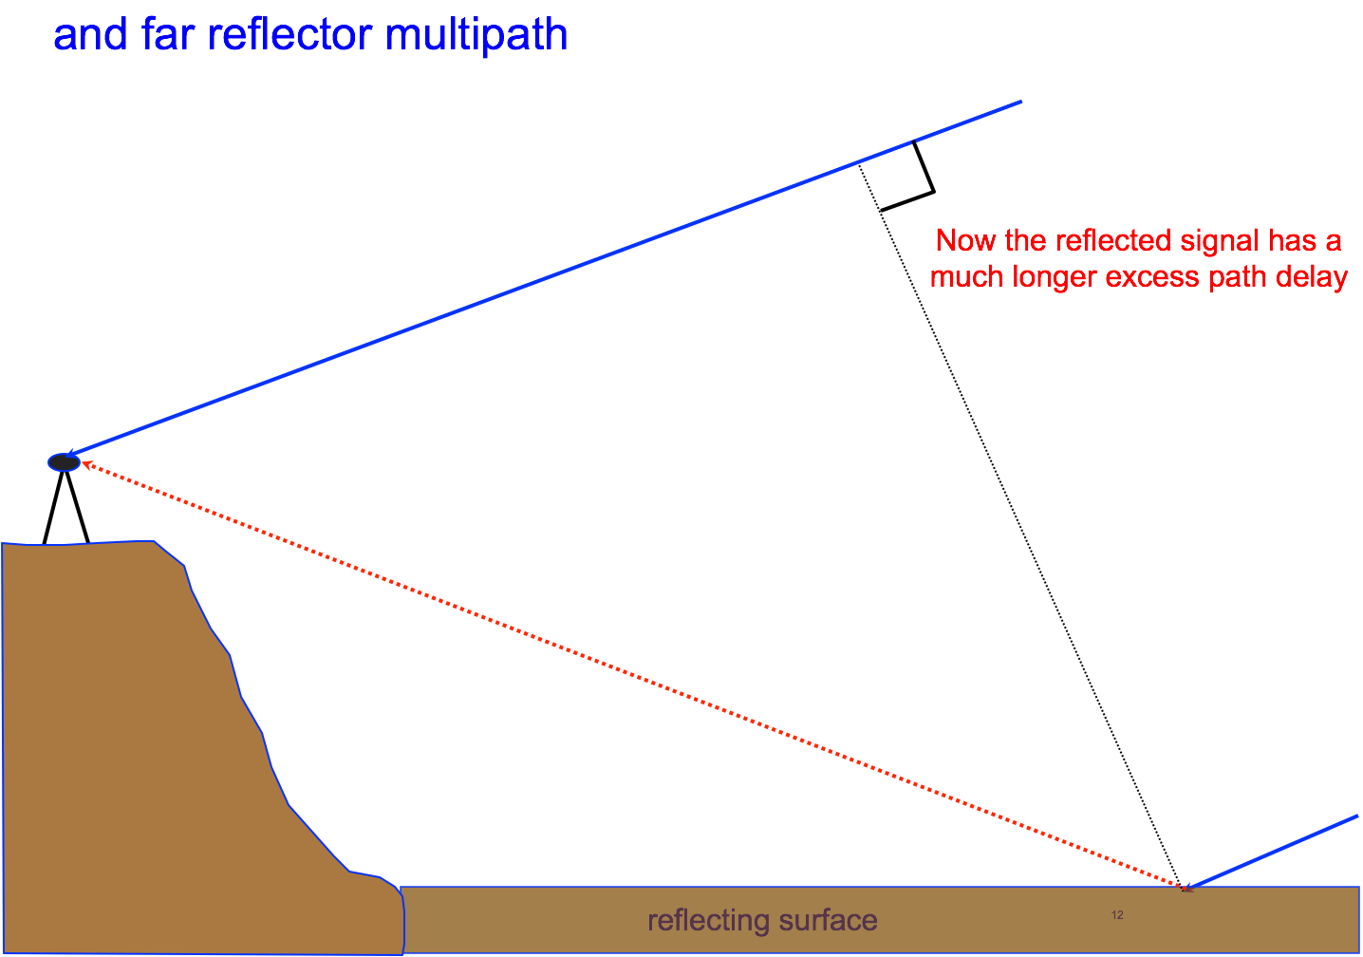

Slide 32
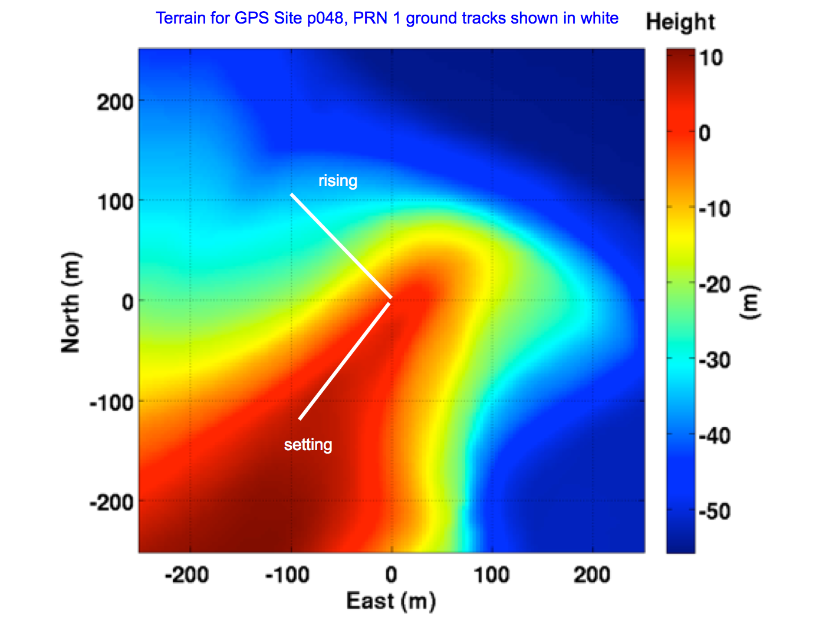

Slide 33
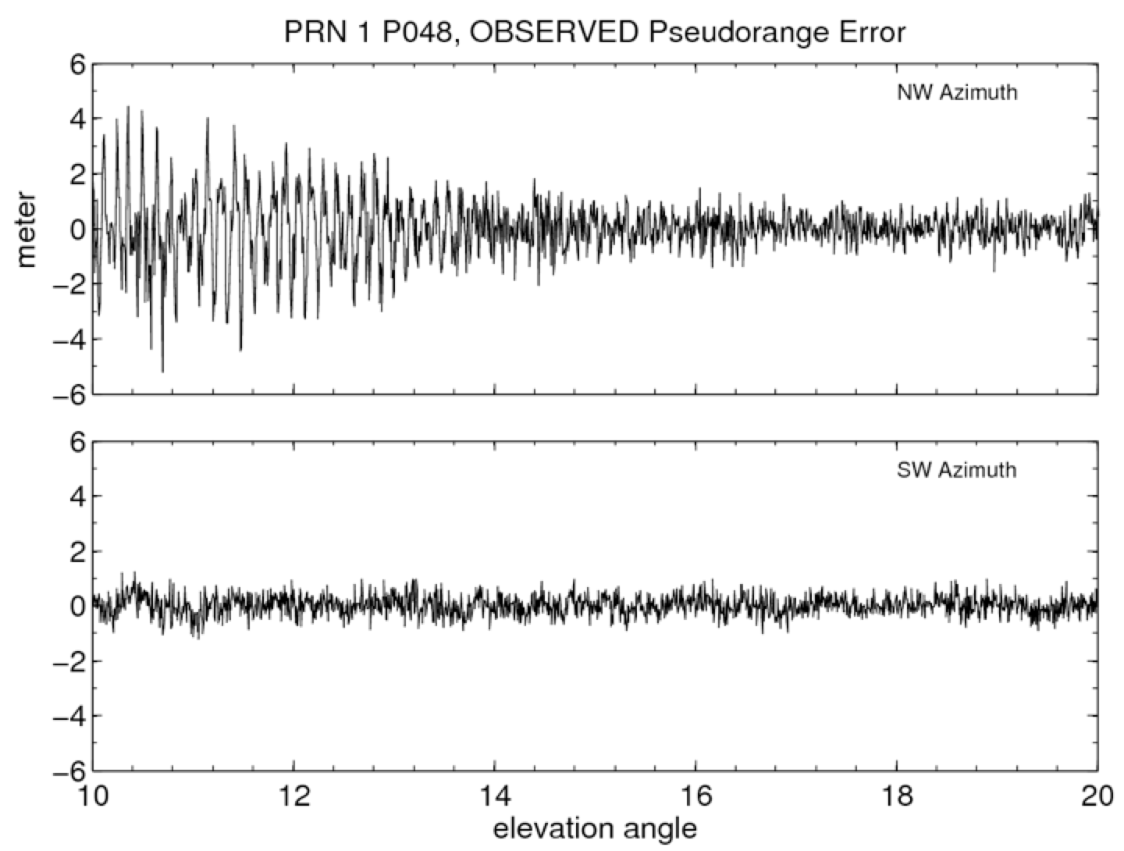

Slide 34
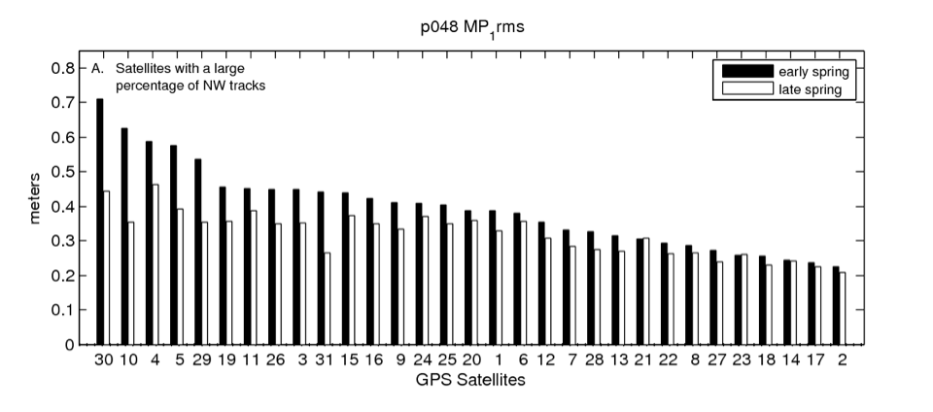
Standard Deviation of L1 Pseudorange Error
Many network operators provide the average of these values each day. Opportunity for easy remote sensing.

Slide 35
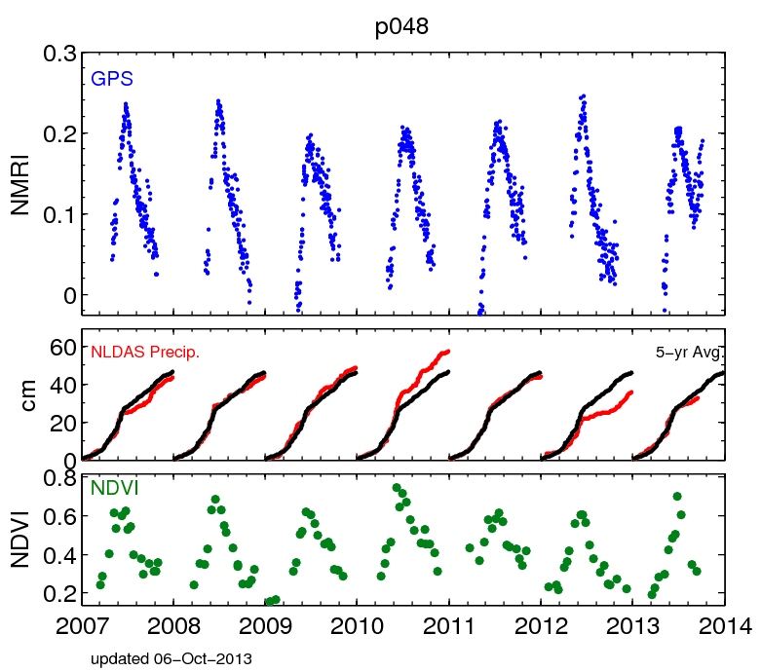
Many network operators provide the average of these values each day. Opportunity for easy remote sensing.

Slide 36
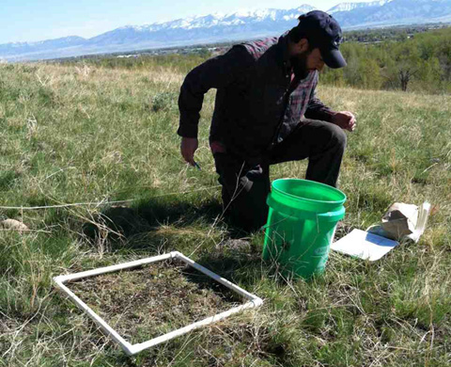
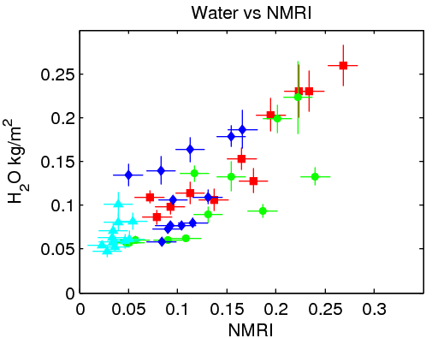
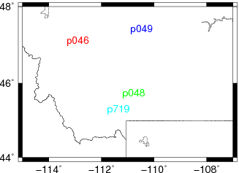
GPS Reflection Ratio
Good agreement with in situ sampling of the vegetation.

Slide 37
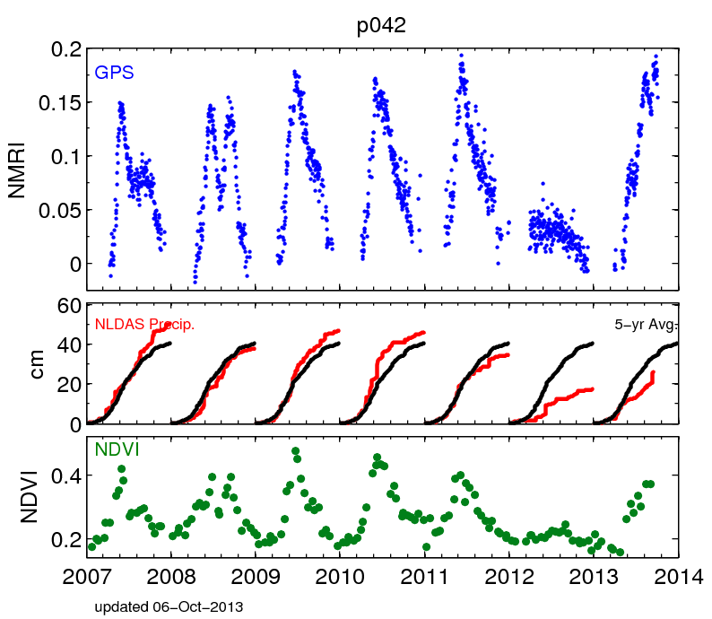
Many network operators provide the average of these values each day. Opportunity for easy remote sensing.

Slide 38
Many network operators provide the average of these values each day. Opportunity for easy remote sensing.

Slide 39
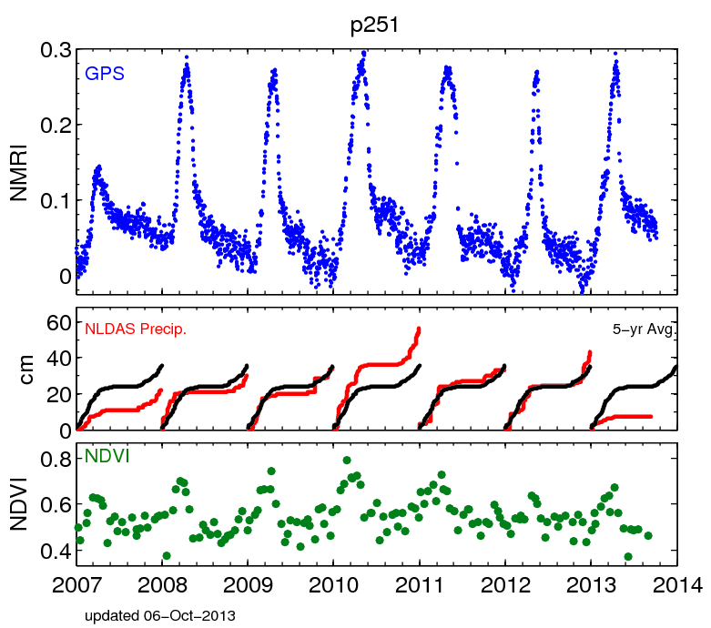
Many network operators provide the average of these values each day. Opportunity for easy remote sensing.

Slide 40
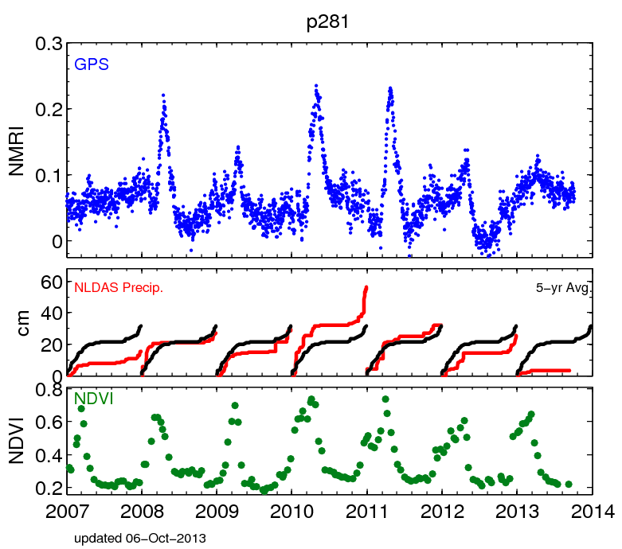
Many network operators provide the average of these values each day. Opportunity for easy remote sensing.

Slide 41
How does that extra path length influence the GPS observables? 1. Pseudorange 2. Signal to Noise Ratio data

Slide 42



Slide 43
What should signal strength data look like?

Slide 45
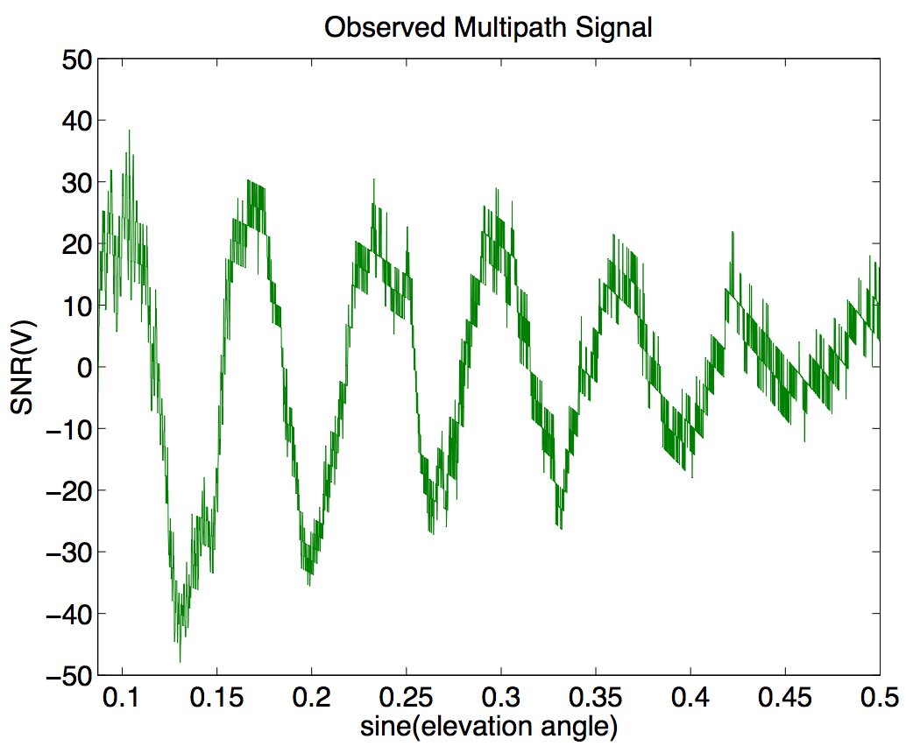
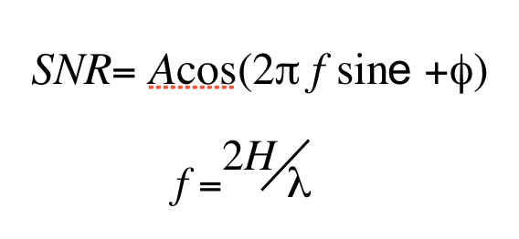
the reflected signal

Slide 46
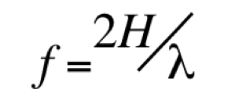
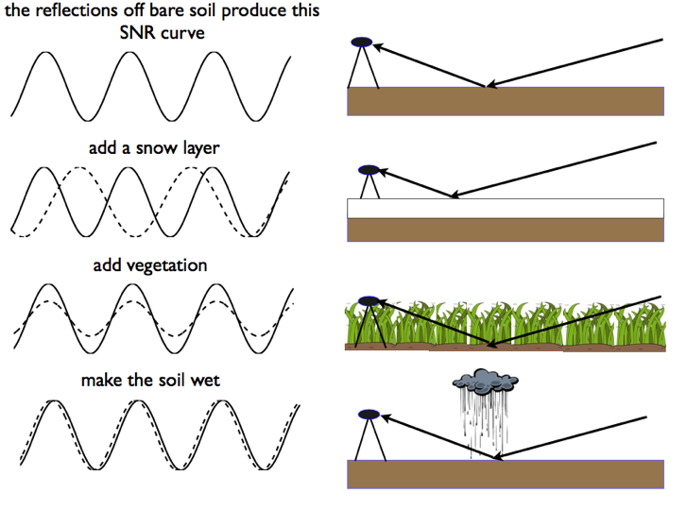

Slide 47
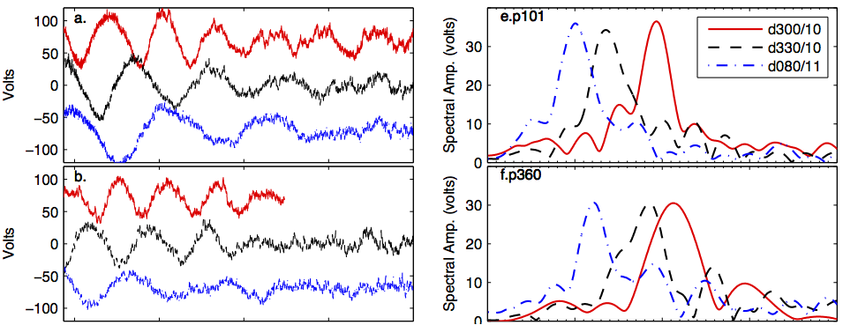
SNR Data
Periodogram

Slide 48
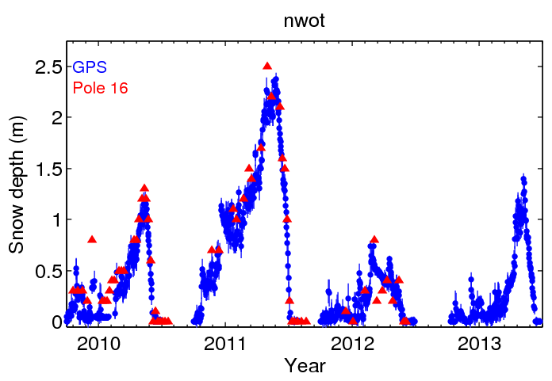

Slide 49
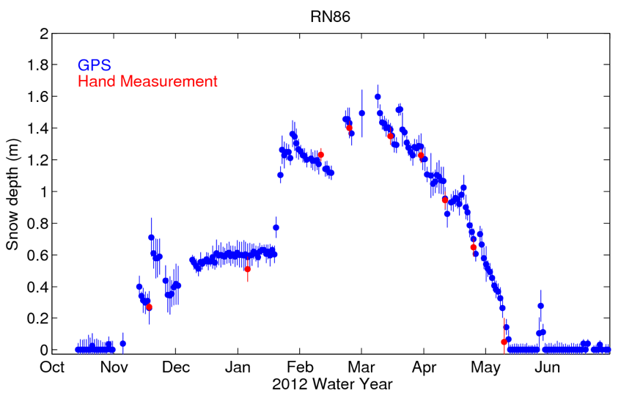

Slide 50
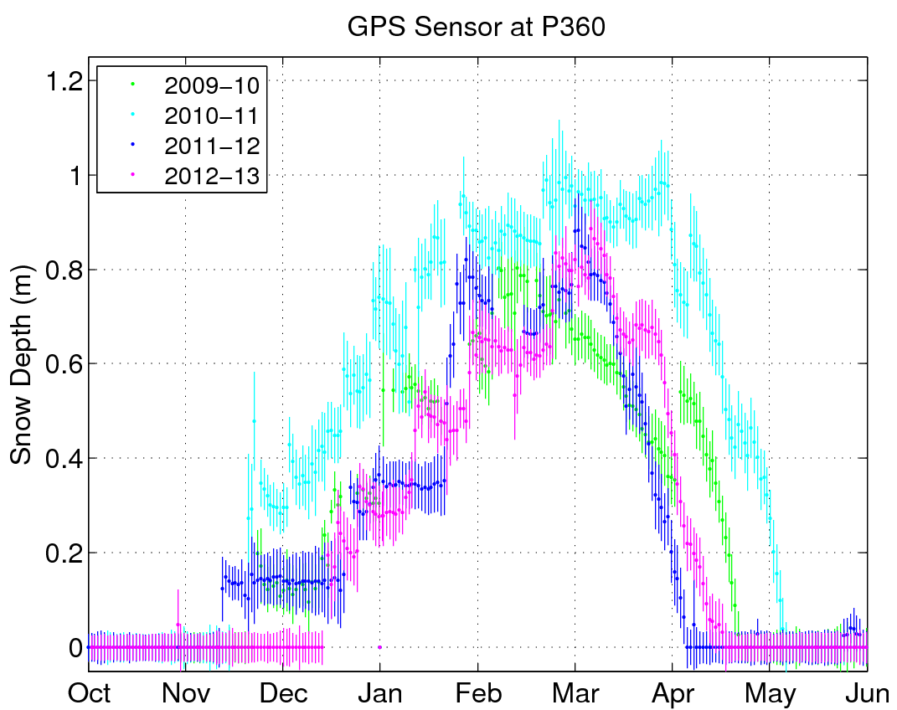

Slide 51
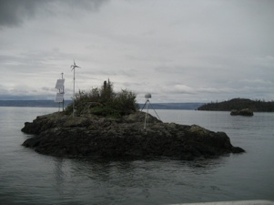
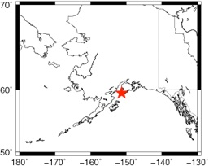
Peterson (Kachemak) Bay, Alaska
GPS site installed to measure crustal deformation
Larson et al., The Accidental Tide Gauge, IEEE GRSL, online.

Slide 52
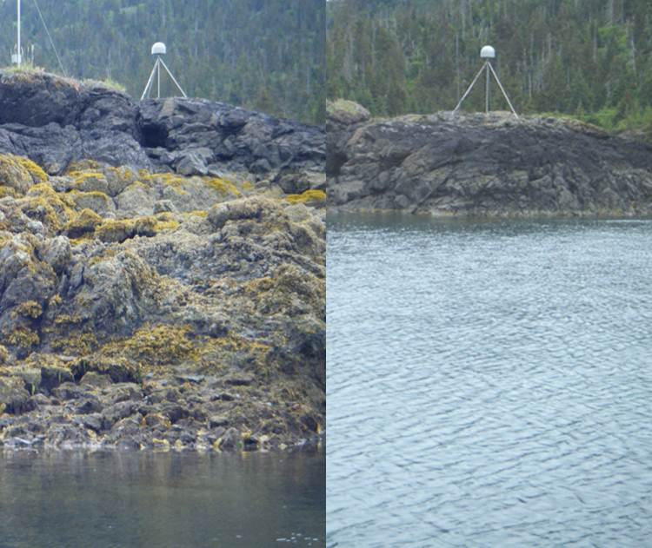
Photo courtesy of Clara Chew
Very big tides-7 meters!

Slide 53
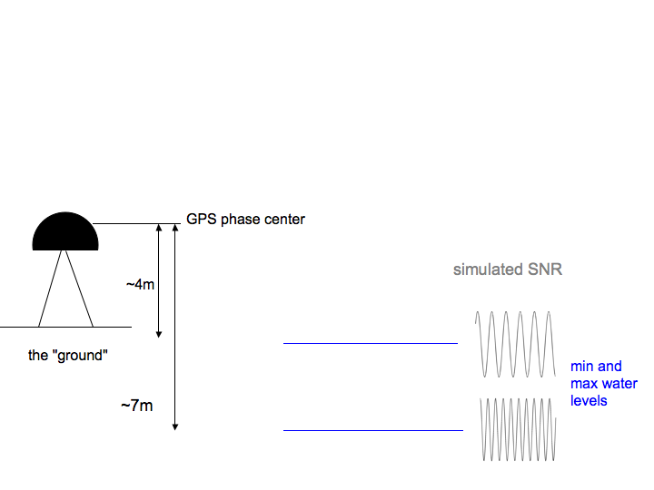
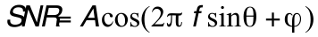
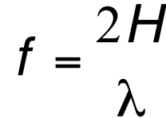
Simple model (assumes horizontal planar reflector)
For SNR (and carrier phase) data
SNR= Acos(2π f sinθ +φ)
e
f =^{2H} λ
H

Slide 54

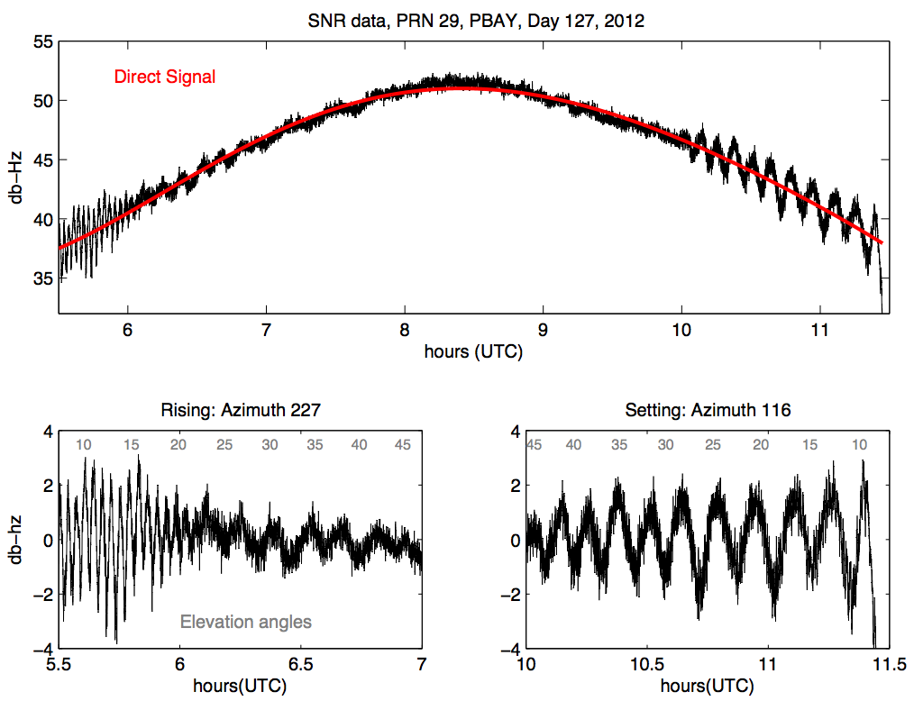
What do the SNR data look like?

Slide 55
